Slide 1




Nǐhǎo Zhōnɡɡuó
你好 中国
Hello China

Slide 2


田林艳
Tián línyàn
Tián lăoshī
田 老师
teacher

Slide 3
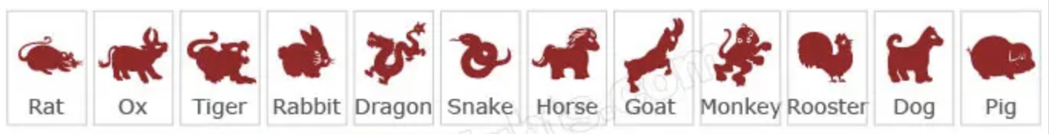
Chinese Zodiac
Introduction of Chinese Zodiac
Origin of Chinese Zodiac
12 Chinese Zodiac Sign Symbolism
Your zodiac animal
Ben Ming Nian(Zodiac Year of Birth)

Slide 4

What is Chinese Zodiac?
shíèr shēngxiào
十二 生肖
Ancient zoolatry&2000years
Represent years & influence people's personalities

Slide 5
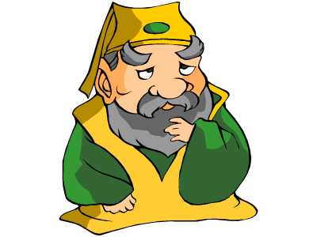


What is Chinese Zodiac?
2020 Year of the Rat
January 25th-February 11th

Slide 6

Origin of Chinese Zodiac
What are the 12 Chinese zodiac animals?
What is the order of them?
https://www.youtube.com/watch?v=may2s9j4RLk

Slide 7
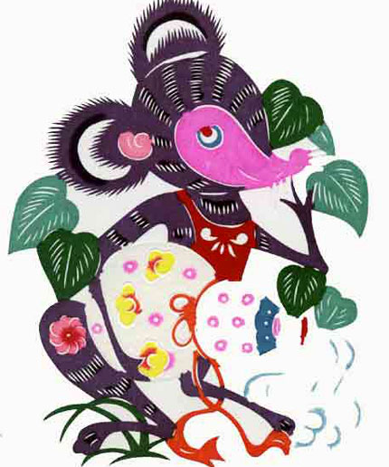
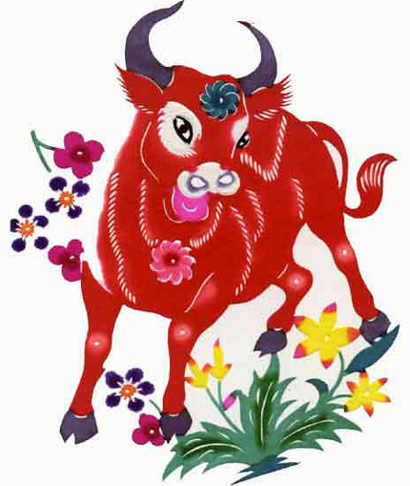
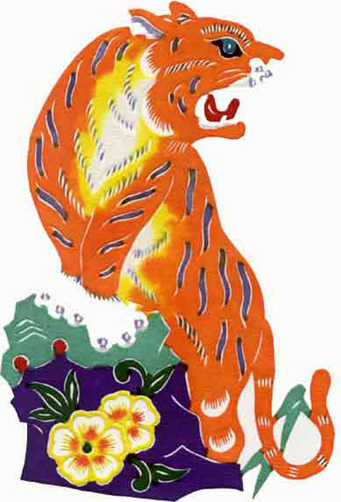
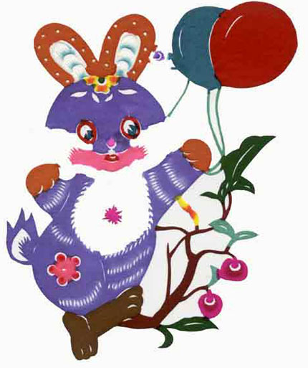
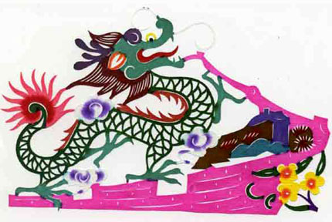
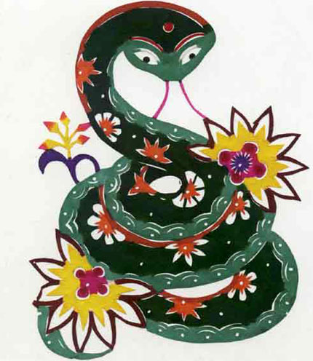
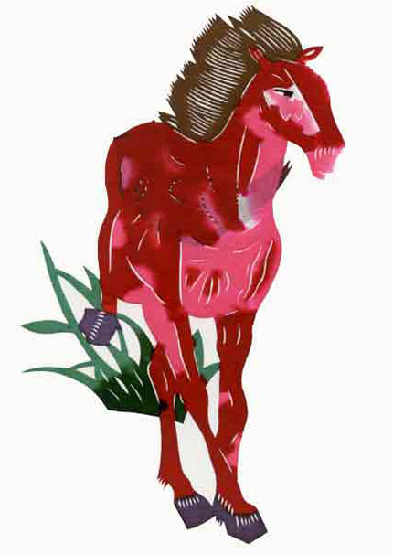
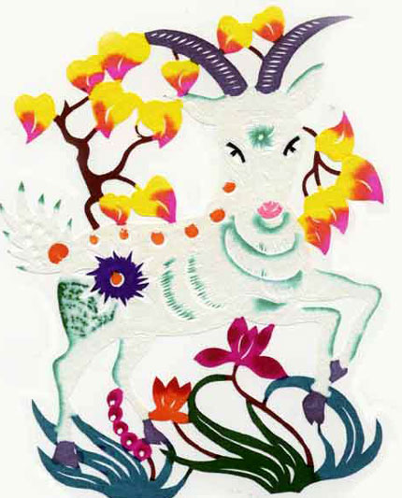
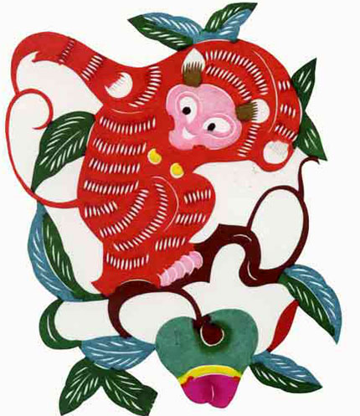
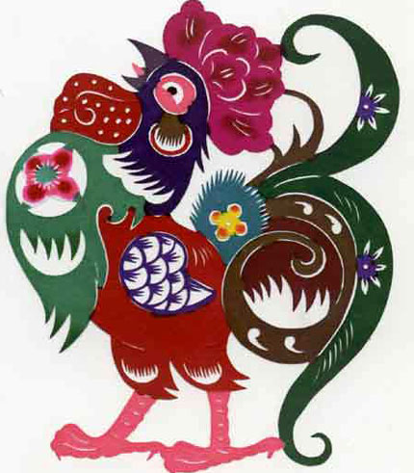
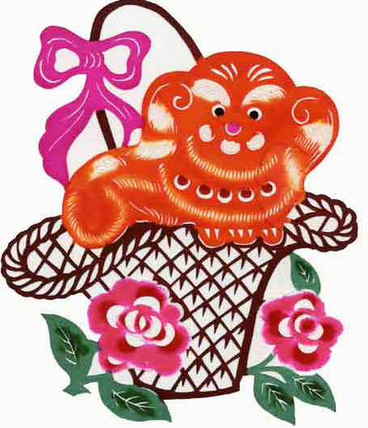
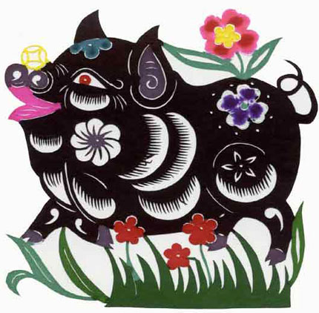
Origin of Chinese Zodiac

Slide 8

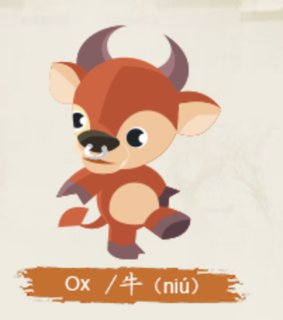
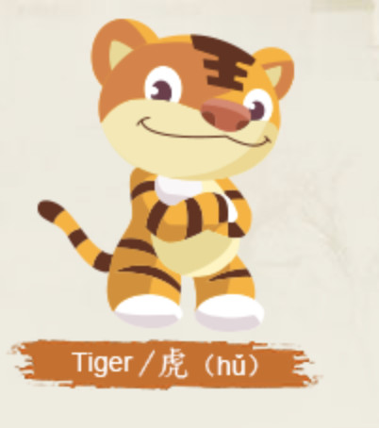
12 Chinese Zodiac Sign Symbolism
smart
quick-witted
strong-willed
ambitious
faithful
obliging
persistent
sympathetic
courageous
confident
with a spirit of adventure

Slide 9
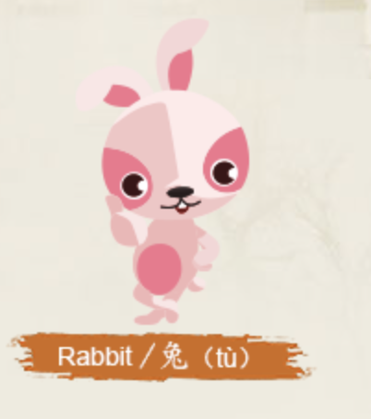
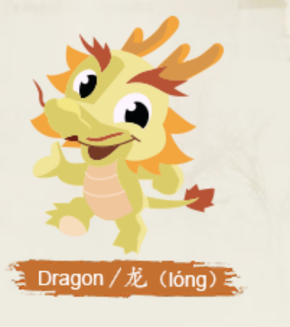

12 Chinese Zodiac Sign Symbolism
gentle
elegant
self-disciplined
alert
confident, resolute
strong
proud
calm
wise
observant
mysterious
think deeply

Slide 10
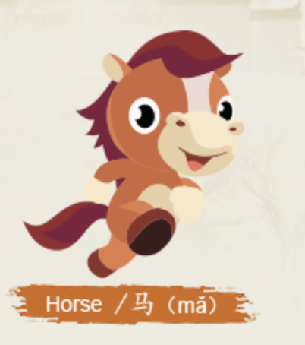
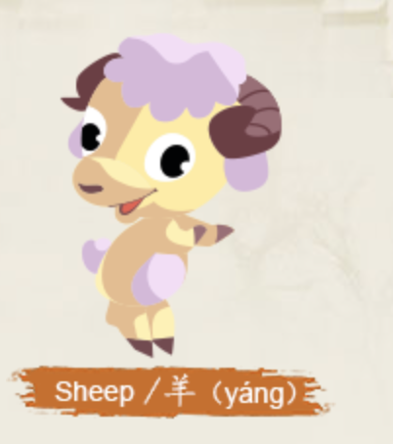
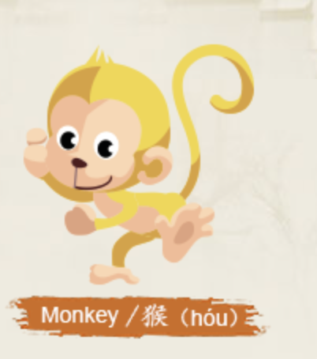
12 Chinese Zodiac Sign Symbolism
cheerful
enthusiastic
insightful
considerate
gentle
calm
upright
sympathetic
lively
clever
agile
competitive
sociable

Slide 11
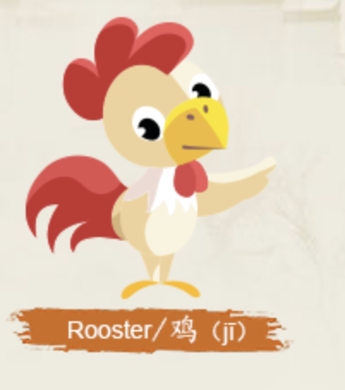

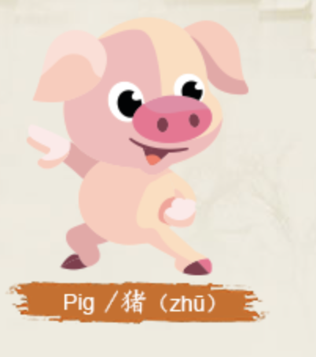
12 Chinese Zodiac Sign Symbolism
independent
capable
warm-hearted
self-respect
quick minded
honest
loyal
reliable
quick-witted
diligent
upright
compassionate
responsible

Slide 12
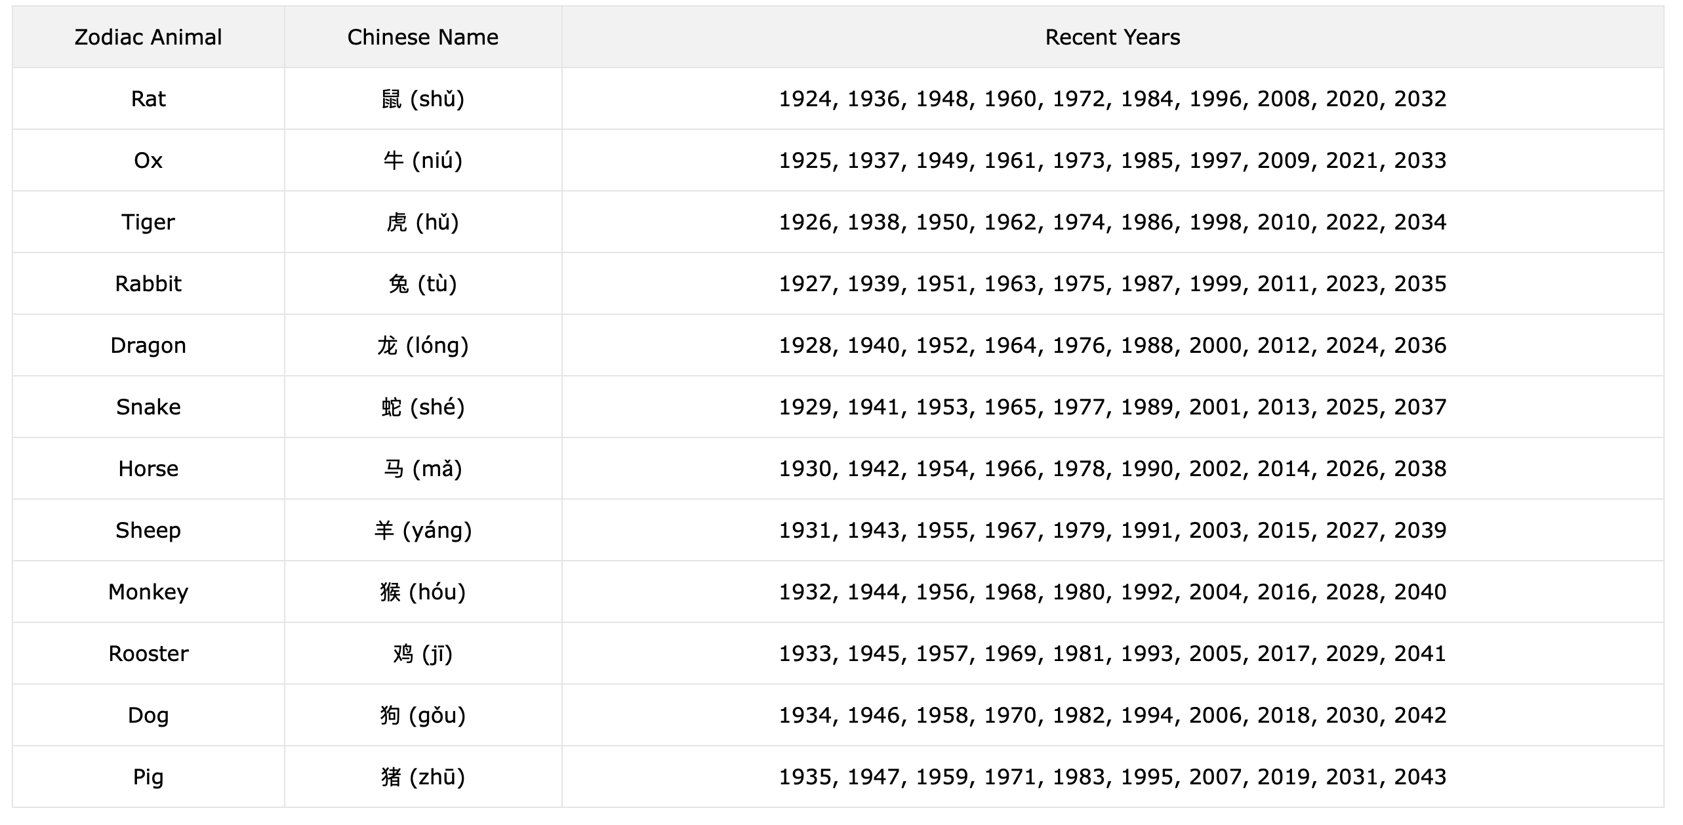
What's Your Zodiac Animal?
Lunar calendar
January&February

Slide 13
Year | Date | Chinese Zodiac Year
2002 | Feb. 12, 2002 – Jan. 31, 2003 | Horse
2003 | Feb. 01, 2003 – Jan. 21, 2004 | Sheep/Goat
2004 | Jan. 22, 2004 – Feb. 08, 2005 | Monkey
2005 | Feb. 09, 2005 – Jan. 28, 2006 | Rooster
2006 | Jan. 29, 2006 – Feb. 17, 2007 | Dog
2007 | Feb. 18, 2007 – Feb. 06, 2008 | Pig
2008 | Feb. 07, 2008 – Jan. 25, 2009 | Rat
2009 | Jan. 26, 2009 – Feb. 13, 2010 | Ox
2010 | Feb. 14, 2010 – Feb. 02, 2011 | Tiger
2011 | Feb. 03, 2011 – Jan. 22, 2012 | Rabbit
2012 | Jan. 23, 2012 – Feb. 09, 2013 | Dragon
2013 | Feb. 10, 2013 – Jan. 30, 2014 | Snake
2014 | Jan. 31, 2014 – Feb. 18, 2015 | Horse
2015 | Feb. 19, 2015 – Feb. 07, 2016 | Sheep/Goat
2016 | Feb. 08, 2016 – Jan. 27, 2017 | Monkey
2017 | Jan. 28, 2017 – Feb. 15, 2018 | Rooster

Slide 14

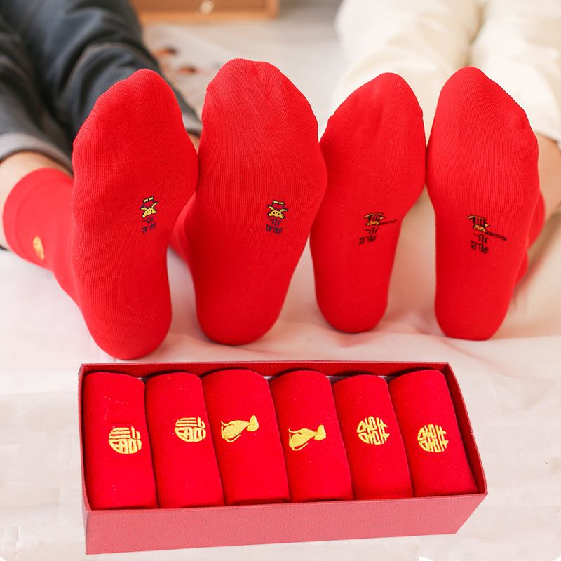
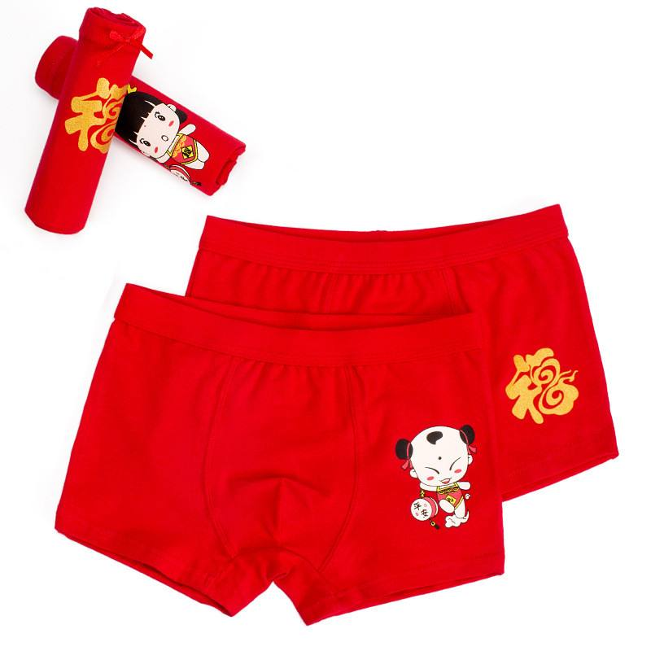

Ben Ming Nian(Zodiac Year of Birth)
Chinese Zodiac Birth year
12,24,36,48,60,72
A Chinese zodiac bad luck year
Dressing in red

Slide 15



xièxie
谢谢
thank you
zàijiàn
再见
goodbye
*Pictures are from Google Images; Videos are from YouTube.
Cardiff Confucius Institute
Communicating Chinese language and culture in Wales
www.cardiff.ac.uk/confucius-institute

